Slide 1
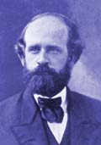
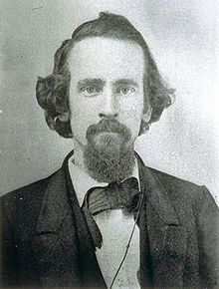
About Henry George
Born in Philadelphia
Becomes a reporter in California
Comes to believe that the separation of rich and poor is too extreme
Feels that tax policy could relieve this split
Formulates the one tax strategy

Slide 2
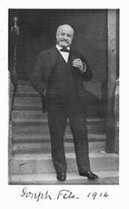
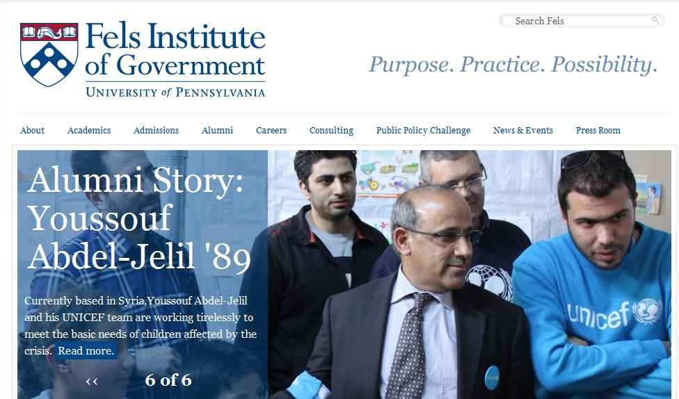
Joseph Fels and the Fels Family
Joseph Fels made millions creating Fels Naptha, still sold today
Was an adherent of Henry George’s theories
Attempted to change Delaware into a single tax state
After the above was unsuccessful, helped create little enclaves adhering to George’s theories including Arden
After Fels died, his wife and brother continued his charitable work
The brother, Samuel Fels, endowed the franklin Institute to create the Fels Planetarium
Samuel also endowed the University of Pa to create the Fels institute of Government.

Slide 3
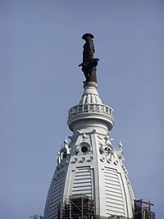
About Joseph Stephens
Famous sculptor from Philadelphia
Brother in law of Thomas Eakins who he denounced as immoral
Works on the sculpture of Philadelphia’s City Hall
Follower of Henry George

Slide 4
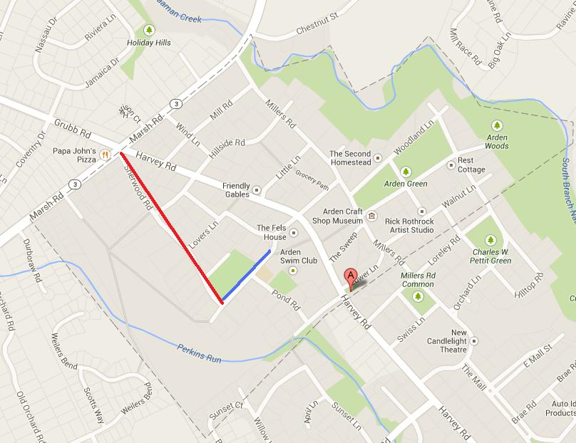
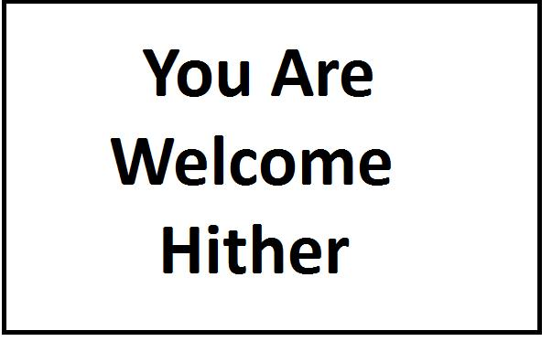
The Creation of Arden, De
Stephens joins Fels and William Price, an architect who designed the home on this slide, in an attempt to change Delaware tax policy
After this failure, Fels buys the Derrickson farm
This 162 acre site – see map - becomes the basis of Arden, a one tax municipality
Thanks to Stephens and Price, Arden develops as an art colony whose motto is “You are welcome hither”

Slide 5
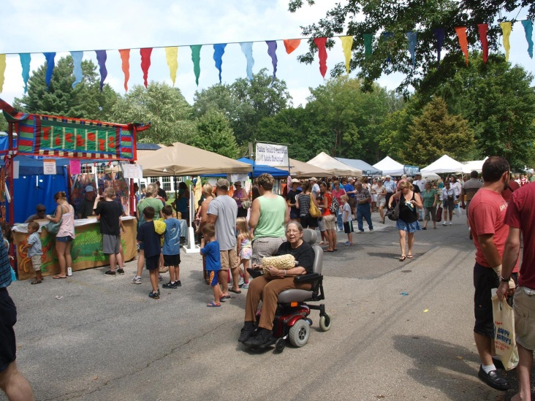
The Early Days of Arden
Tends to start as a summer art colony although eventually the residents live there year round
Creates the Arden Club made up of art associated Gilds
Builds the Gild Hall in 1907/08
Holds an end of summer fair on the Saturday of the Labor Day weekend

Slide 6
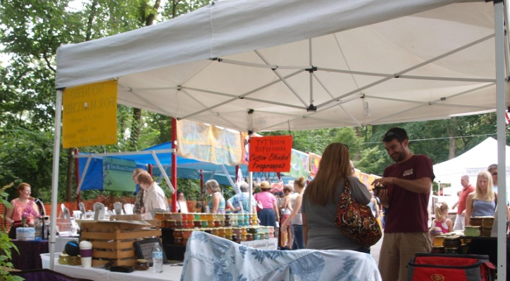
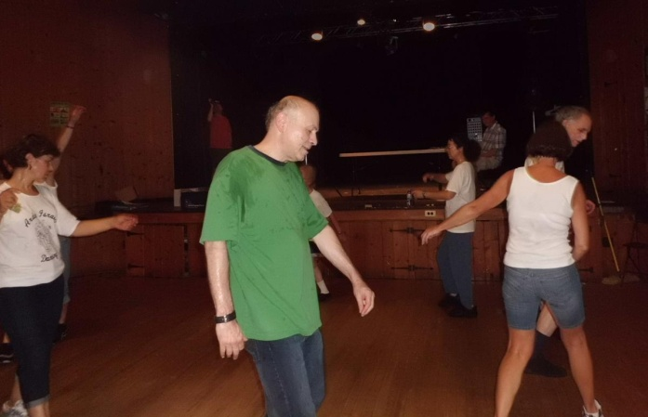
The Annual Arden Fair
Since 1907 held every Labor Day Saturday (this year on August 31st)
12 hours of rock and jazz bands spread music throughout the area
Kiosks exhibit plenty of arts and crafts
It has a large book swap amid dance demonstrations in the Gild hall

